Slide 1
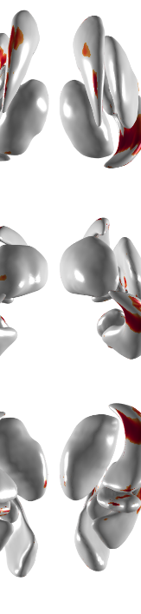

Subcortical Shape Analysis in Correlation with Fatigue in Neuromyelitis Optical Spectrum Disorder and Multiple Sclerosis
Doo Hwan Son
Korea University
School of Biomedical Engineering
Brain Reverse Engineering by Intelligent Neuroimaging (BREIN Lab.)
2020/ 06/ 16

Slide 2
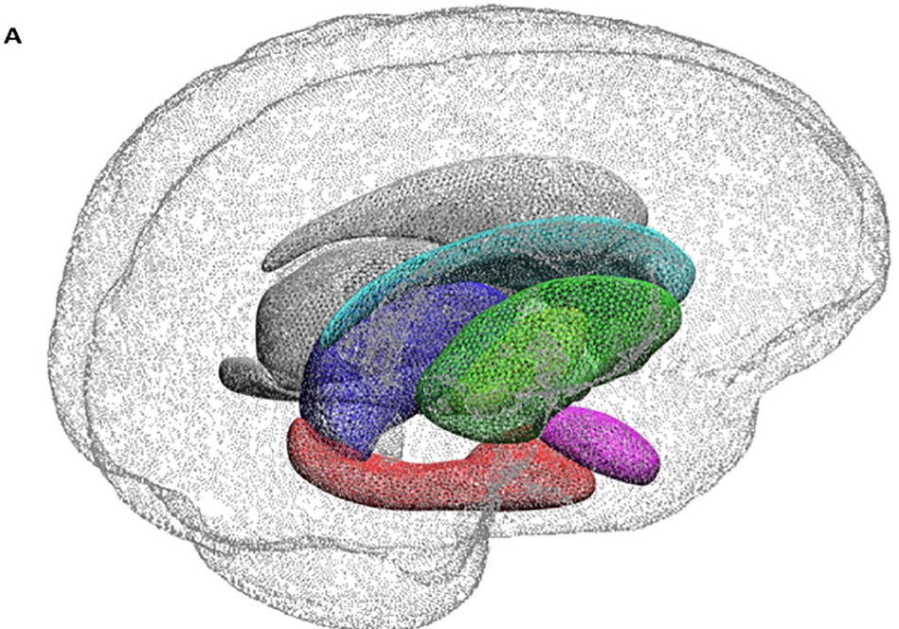
Background
Introduction
Contribution
Method
Result
Discussion
Conclusion

Slide 3

Background: Fatigue
Not the feeling of being exhausted after heavy exercise or busy day
Involves sudden loss of energy and not being able to continue an activity
Fatigue can also affect cognitive symptoms
Short term memory, concentration or word finding

Slide 4
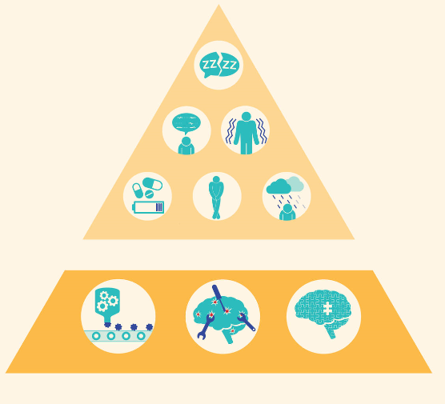
Background: Causes of fatigue
Sleep problems
Speech problems
Tremor
Medication
Bladder problems
Depression
Secondary fatigue
Cytokines
Brain repair
Damaged fatigue control
Primary fatigue

Slide 5
Background: Causes of fatigue
Secondary fatigue
Drug, depression, sleep disorder
Sleep problems
Speech problems
Tremor
Medication
Bladder problems
Depression
Secondary fatigue
Cytokines
Brain repair
Damaged fatigue control
Primary fatigue

Slide 6
Background: Causes of fatigue
Secondary fatigue
Drug, depression, sleep disorder
Primary fatigue
Central fatigue
Activated immune system
Brain damage
Hormone
Peripheral fatigue
Muscle, neuronal damage
Sleep problems
Speech problems
Tremor
Medication
Bladder problems
Depression
Secondary fatigue
Cytokines
Brain repair
Damaged fatigue control
Primary fatigue

Slide 7
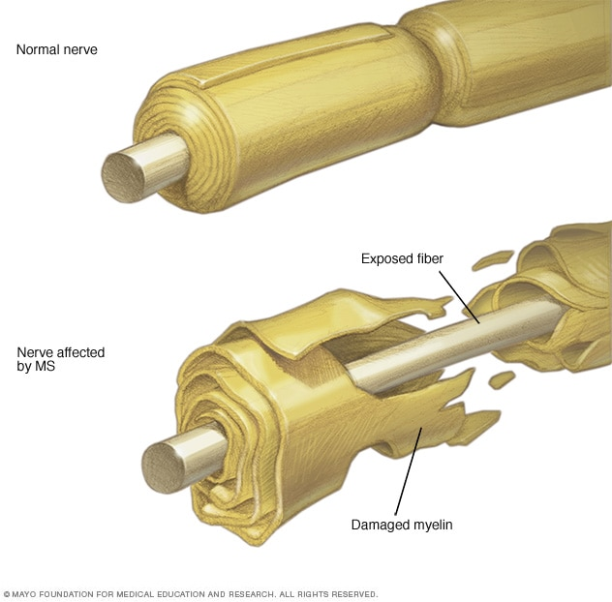
Background: Multiple Sclerosis
Neuronal immune-mediated ‘Fatigue’
50~80 % of Multiple Sclerosis (MS)
Symptom: the immune system attacks the protective sheath (myelin) that covers the nerve fibers and causes communication problem between brain and the rest of body

Slide 8
Background: Neuro Myelitis Optica Spectrum Disorder
Neuronal immune-mediated ‘Fatigue’
Neuro Myelitis Optica Spectrum Disorder (NMOSD)
71.4% of NMOSD patients showed fatigue symptom [Jm Seok, et al., 2017]
Immune-mediated chronic inflammatory disorder of the central nervous system especially in the optic nerve and the spinal cord [Hiroaki Yokote, et al., 2016]
Similar with MS but defined in 2015 as independent disease
Notes:
[Hiroaki Yokote, et al., 2016]: Multiple sclerosis and neuromyelitis optica spectrum disorders: some similarities in two distinct diseases

Slide 9
Background: clinical issue
Research trend
MS: various studies using brain MRI revealed relation with frontal lobe, basal ganglia
Basal ganglia volume
Cortical thickness
White matter lesion volume
Functional/ structural connectivity
NMOSD: studies mainly about secondary fatigue
Correlation between depression and fatigue
Correlation between sleep problem and fatigue
Naïve correlation between subcortical volume and cognitive impairment

Slide 10
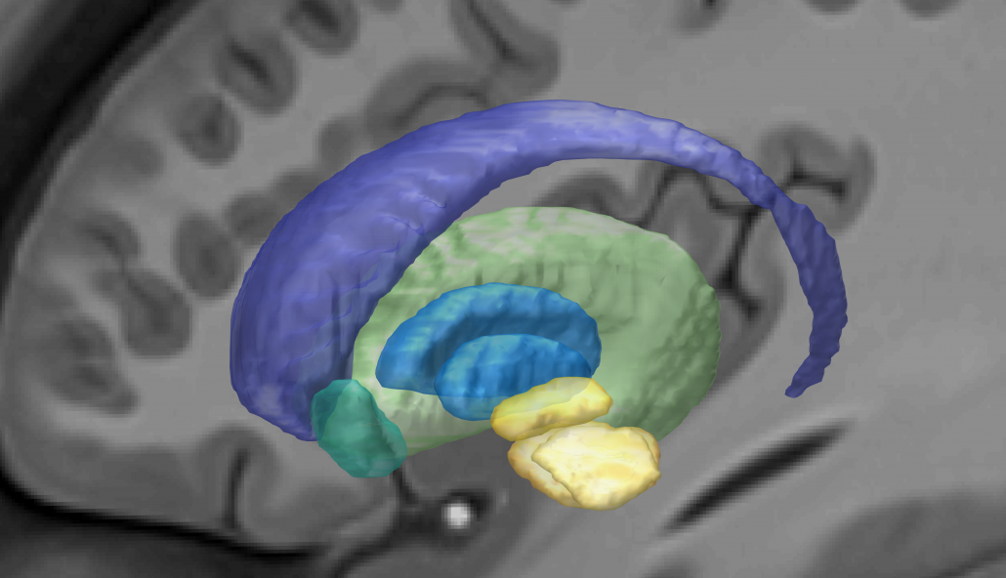
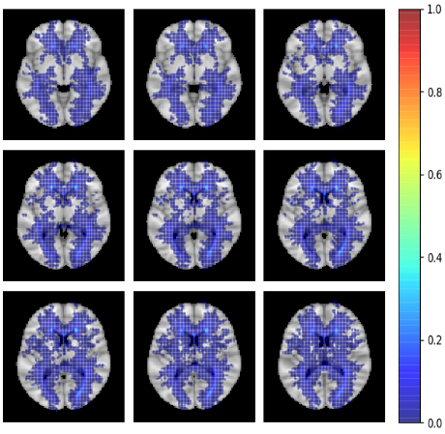
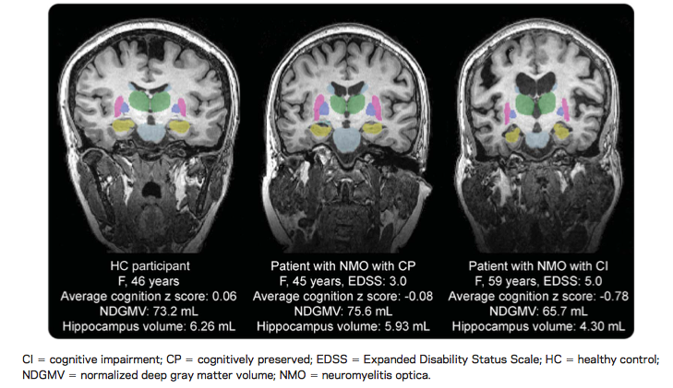
Introduction: Research Question
Need more research about NMOSD with primary fatigue
Where is brain atrophy ?
To refer to the MS studies: Basal ganglia, deep gray matter (subcortical) volume might be important
Previous researches
Roughly correlated volume and clinical score
★ Localization of significant area in NMOSD patients correlated with fatigue
Human brain basal ganglia
NMOSD WMH lesion map
NMO correlation analysis between subcortical volume and cognitive impairment [Yaou Liu ,et al. 2015]
Notes:
White matter hyperintensity map 상 white matter영역, 특히 3rd ventricle 주위에 lesion이 많으므로 subcortical영역이 유의미할 확률이 높다
수술이 필요한 경우, 수술 대상 부위를 정하는데 도움을 줄 수 있다.
왜 voxel based가 아닌, surface mesh based인가 ?
왜 surface mesh중에 Local shape volume인가? Deformation map은? Voxel-wise t-test나 다른 correlation method?

Slide 11
Background
Introduction
Contribution
Method
Result
Discussion
Conclusion

Slide 12
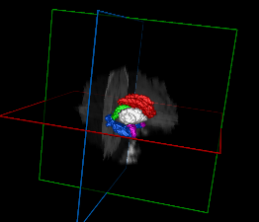
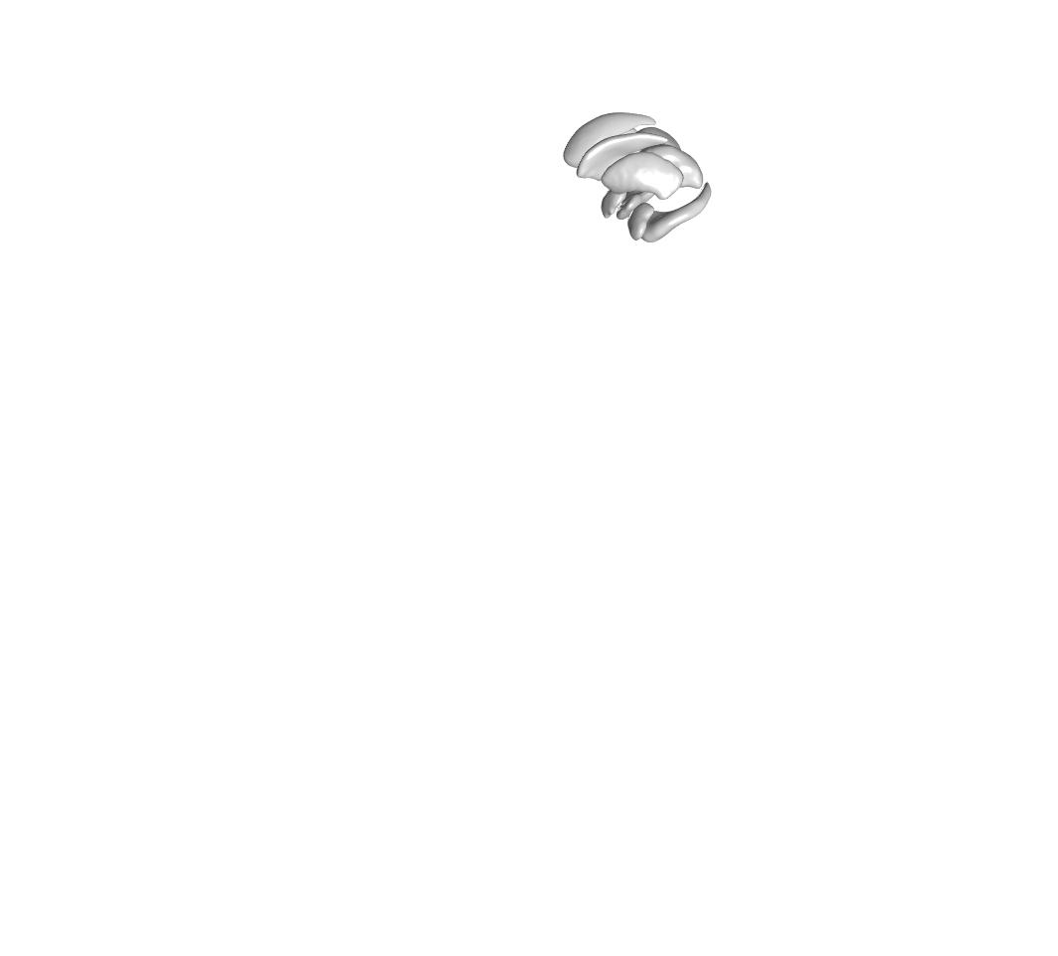
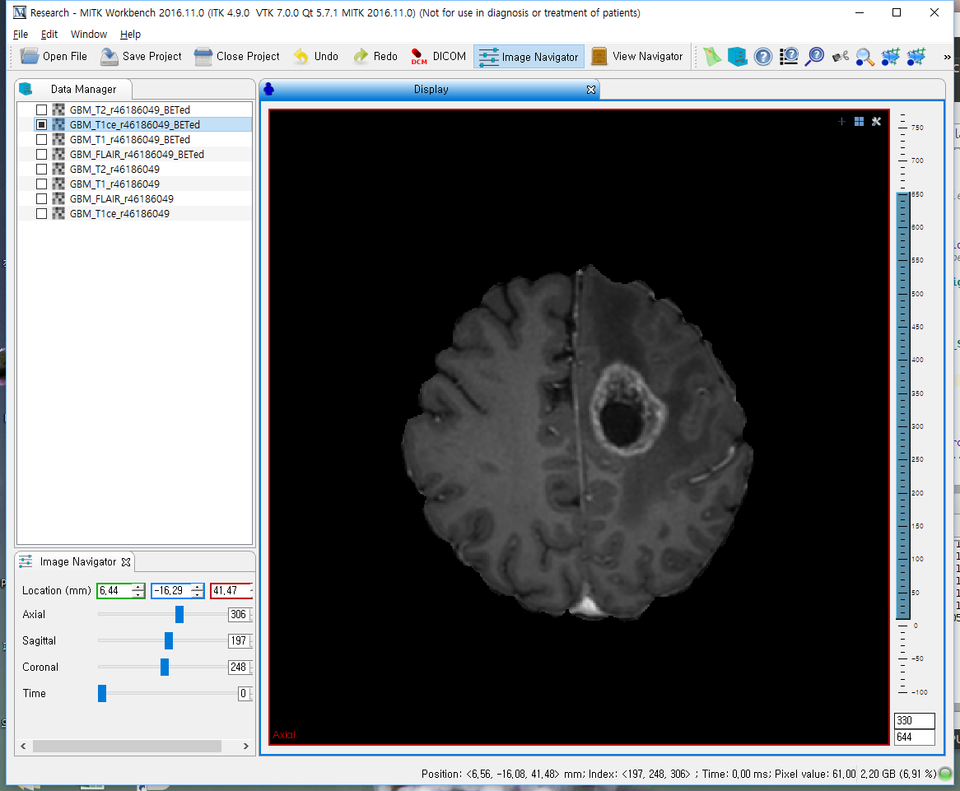


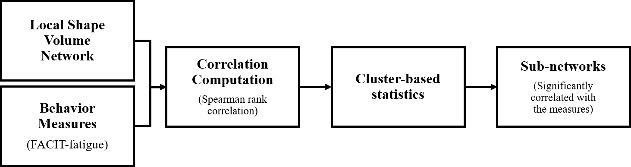
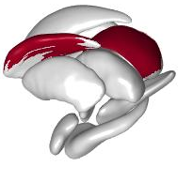

Method Overview
Image Processing
Freesurfer Pipeline
(A)
Surface Extraction
Surface Registration
$$⋯$$
Individual Stats Information
Subcortical Surfaces
Subcortical Template
Registered Subcortical Shape
SMC T1 data
Demography
(B)
Statistical Analysis
Significant
Sub-Network Visualization

Slide 13
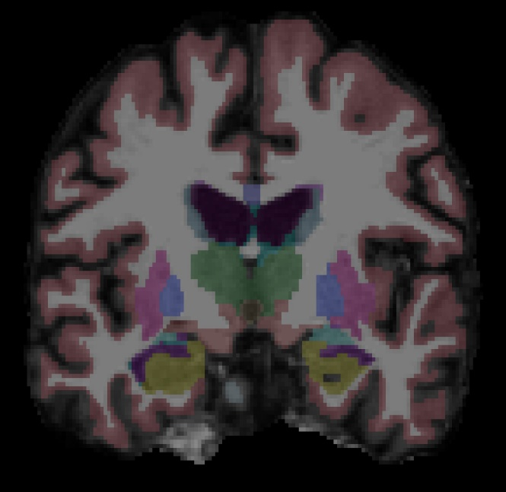
Method: Subcortical Structure Pre-processing
Human subcortical structure parcellation from T1 MR image
With Freesurfer v6.0
Segment brain with Desikan/Killiany atlas
Parceled images on native anatomical space
Notes:
Transform the parceled images to native anatomical space for surface extraction

Slide 14
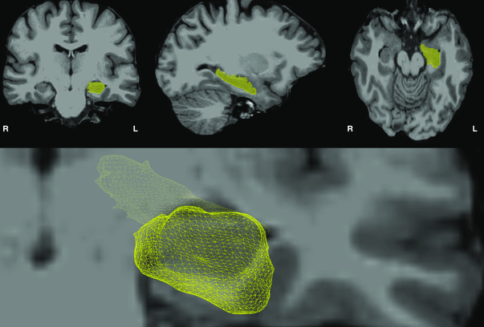
Method: Subcortical Structure Pre-processing
Surface mesh extraction
Deforming the template Subcortical shape atlas model [Qiu A, et al.,2009]
Extract individual subcortical surface using Laplacian-based surface deformation [Sorkine O, et al., 2006], [Kim J, et al., 2012]
Extracted Hippocampus surface mesh

Slide 15
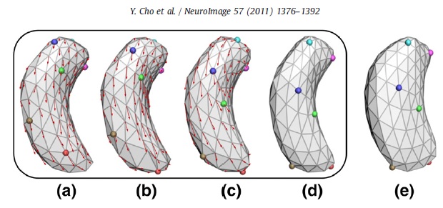
Method: Subcortical Structure Pre-processing
Surface registration
establish the vertex correspondence of subcortical meshes across the sample
Surface registration procedure
Notes:
추출된 surface는 단순히 모델링만 된 것이므로 registration으로 각각의 vertex index가 동일한 부분에 위치하도록 해준다.

Slide 16
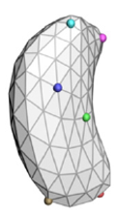
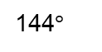
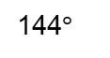
Method: Subcortical Structure Pre-processing
Local shape volume (LSV) of each vertex
A measure of the diameter of the object’s volume in the neighborhood of each point on the surface [Lior Shapira, et al., 2008]
144$°$
144$°$
Local shape volume calculation
(Large value)
Local shape volume calculation
(Small value)
Notes:
The weights used are the inverse of the angle between the ray to the center of the cone. This is because rays with larger angles are more frequent, therefore having smaller weights.

Slide 17
Method: Statistical analysis overview
Spearman rank correlation (non-parametric)
Can handle unknown distribution of LSV data
Do not require healthy populations to contrast
Reduce the effects of the other compounding factors
Can identify nodes that capture a specific correlation with cognitive functions
(B)
Statistical Analysis
Significant Region Visualization

Slide 18
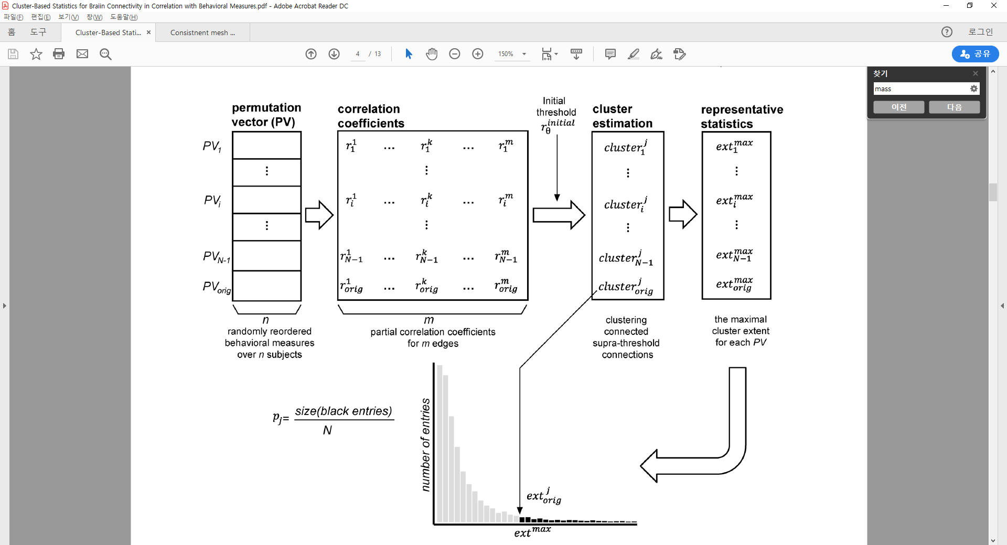
Method: Cluster based statistics (CBS)
Multiple comparison correction
$$⋯$$
randomly reordered behavioral measures over n subjects
partial correlation coefficients
for m nodes
Notes:
Biomedical data generally have weak correlations. CBS solves too conservative multiple comparison correction than Bonferroni correction, FDR correction, extreme statistics.
P-value는 maximum cluster extent의 null distribution으로 permutation test를 진행

Slide 19
Method: Cluster based statistics (CBS)
Multiple comparison correction
randomly reordered behavioral measures over n subjects
partial correlation coefficients
for m nodes
Notes:
Output: set of sub-networks consisting of neighboring connections (significantly correlated with behavioral measures) and corresponding p-values

Slide 20
Method: Data
MR Images
Samsung Medical Center data
102 images (modality: T1)
Error: 4 MS
Base-line only
Questionnaire
FACIT-fatigue scale
Beck Depression Inventory (BDI)
Expanded Disability Status Scale (EDSS)
Fatigue
0
43
52
FACIT-fatigue scale
 | Disease
 | NMOSD | MS
Total | 31 | 71
Base line | 28 | 45
No error base line | 28 | 41
FACIT-fatigue exist | 27 | 41
BDI exist | 24 | 40
EDSS exist | 21 | 37
Depression
0
63
BDI
Disability
0
10
EDSS
Notes:
EDSS: disease severity
Base-line only : for subject 중복 피하기

Slide 21
Background
Introduction
Contribution
Method
Result
Discussion
Conclusion

Slide 22
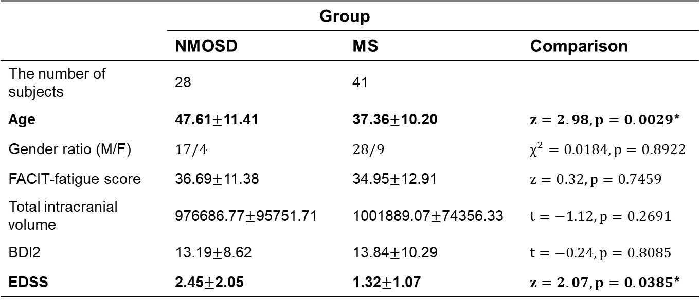
Demography
 | Group
 | NMOSD | MS | Comparison
The number of subjects | 28 | 41
Age | 47.61$±$11.41 | 37.36$±$10.20 | $z=2.98, p=0.0029$*
Gender ratio (M/F) | $17/4$ | $28/9$ | $χ^{2}=0.0184, p=0.8922$
FACIT-fatigue score | 36.69$±$11.38 | 34.95$±$12.91 | $z=0.32, p=0.7459$
Total intracranial volume | 976686.77$±$95751.71 | 1001889.07$±$74356.33 | $t=−1.12, p=0.2691$
BDI2 | 13.19$±$8.62 | 13.84$±$10.29 | $t=−0.24, p=0.8085$
EDSS | 2.45$±$2.05 | 1.32$±$1.07 | $z=2.07, p=0.0385$*
Demography table.
Statistical analysis were performed with Chi-square test for categorical data, Wilcoxon test or Student’s t-test.
Notes:
ICV: [Malone IB, Leung KK, Clegg S, et al.] Accurate automatic estimation of total intracranial volume: a nuisance variable with less nuisance. Neuroimage. 2015;104:366‐372. doi:10.1016/j.neuroimage.2014.09.034
BDI2: [Domenica Nunnari et al]: Impact of Depression, Fatigue, and Global Measure of Cortical Volume on Cognitive Impairment in Multiple Sclerosis

Slide 23
Cluster based statistics (CBS) result
Significant cluster area
Output: clusters of vertices
Covariate: ICV, BDI, EDSS, age, gender
NMOSD regions
MS regions
Significant cluster exist | r (threshold) | P-value
'NMOSD_Right_Thalamus' | 0.2 | 0.002
'NMOSD_Right_Thalamus' | 0.25 | 0.0018
'NMOSD_Right_Thalamus' | 0.3 | 0.0018
'NMOSD_Right_Thalamus' | 0.35 | 0.0016
'NMOSD_Right_Thalamus' | 0.4 | 0.0016
Significant cluster exist | r (threshold) | P-value
'MS_Left_Caudate' | 0.2 | 0.0254
'MS_Left_Caudate' | 0.25 | 0.035
'MS_Left_Caudate' | 0.3 | 0.0326
'MS_Left_Caudate' | 0.35 | 0.0426
'MS_Left_Caudate' | 0.4 | 0.0362
'MS_Left_Pallidum' | 0.25 | 0.0344
'MS_Left_Pallidum' | 0.3 | 0.0212
'MS_Left_Pallidum' | 0.35 | 0.0276
'MS_Left_Pallidum' | 0.35 | 0.0412
'MS_Left_Pallidum' | 0.4 | 0.0402
'MS_Left_Pallidum' | 0.4 | 0.0436
'MS_Left_Putamen' | 0.2 | 0.0446
'MS_Left_Putamen' | 0.25 | 0.0456
'MS_Right_Pallidum' | 0.2 | 0.028
'MS_Right_Pallidum' | 0.25 | 0.0228
'MS_Right_Pallidum' | 0.3 | 0.0252
'MS_Right_Pallidum' | 0.35 | 0.028
'MS_Right_Putamen' | 0.25 | 0.0492
'MS_Right_Putamen' | 0.3 | 0.034
'MS_Right_Putamen' | 0.35 | 0.0234
'MS_Right_Putamen' | 0.4 | 0.0186

Slide 24
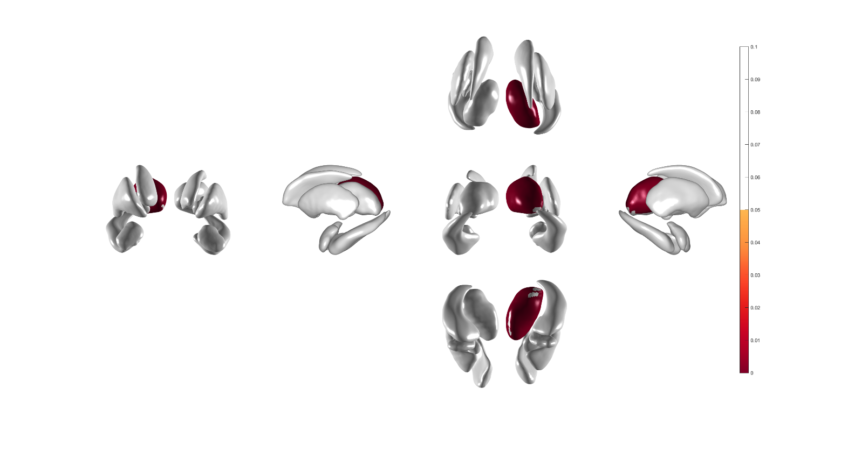
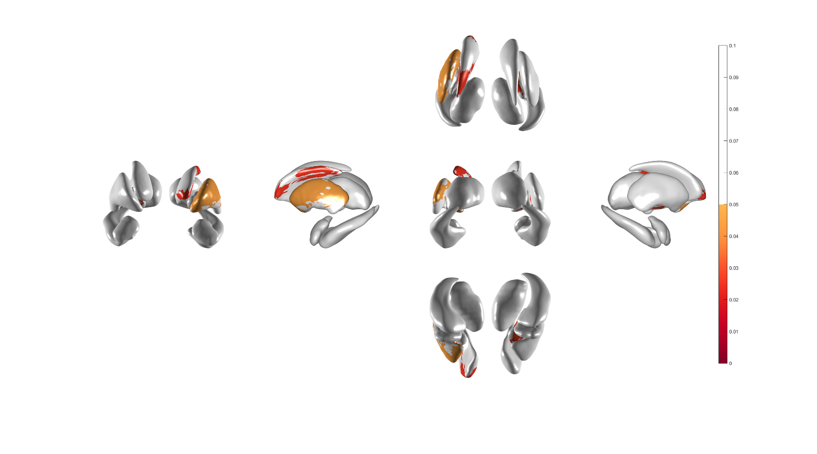
Cluster based statistics (CBS) result
CBS visualization
Threshold 0.2
NMOSD: Right-Thalamus
MS: Left-Caudate, Left-Putamen, Right-Pallidum
Pallidum
Pallidum
Caudate nucleus
Superior → Inferior
Caudate nucleus
Superior → Inferior
Thalamus
Thalamus
Putamen
Putamen
Anterior → Posterior
Amygdala
Hippocampus
Posterior → Anterior
Right
Amygdala
Hippocampus
Posterior → Anterior
Right
Left
Anterior → Posterior
Left
Inferior → Superior
Inferior → Superior
NMOSD
MS

Slide 25

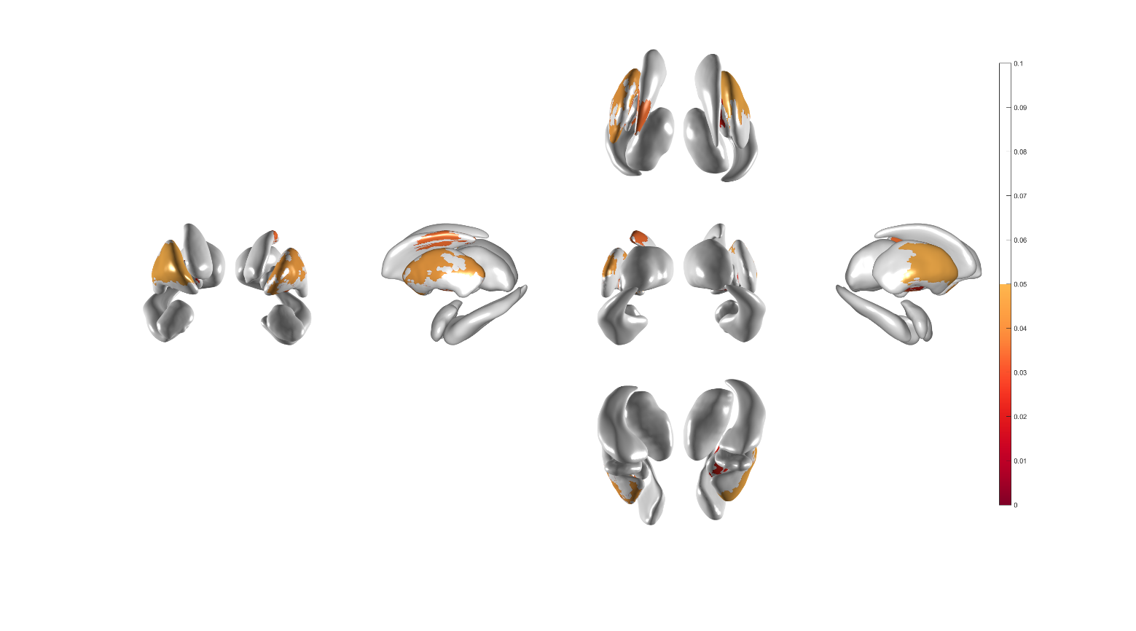
Cluster based statistics (CBS) result
CBS visualization
Threshold 0.25
NMOSD: Right-Thalamus
MS: Left-Caudate, Both-Pallidum, Both-Putamen
Pallidum
Pallidum
Caudate nucleus
Superior → Inferior
Caudate nucleus
Superior → Inferior
Thalamus
Thalamus
Putamen
Putamen
Anterior → Posterior
Amygdala
Hippocampus
Posterior → Anterior
Right
Anterior → Posterior
Amygdala
Hippocampus
Posterior → Anterior
Right
Left
Left
Inferior → Superior
Inferior → Superior
NMOSD
MS
Notes:
The change of the threshold affects the ${ext}_{orig}^{j}$ (the criteria of significance test)
Which make no significant area in one threshold to significant area in the other threshold

Slide 26

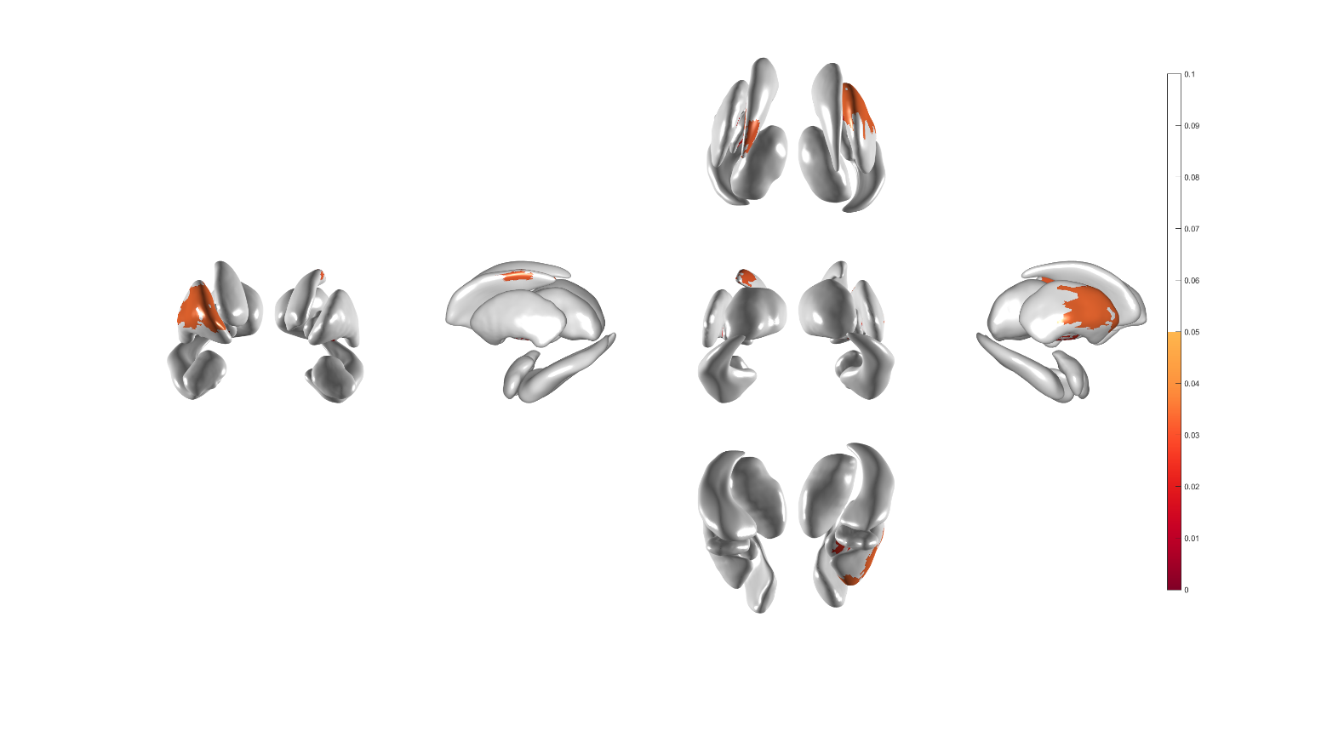
Cluster based statistics (CBS) result
CBS visualization
Threshold 0.3
NMOSD: Right-Thalamus
MS: Left-Caudate, Both-Pallidum, Right-Putamen
Pallidum
Pallidum
Caudate nucleus
Superior → Inferior
Caudate nucleus
Superior → Inferior
Thalamus
Thalamus
Putamen
Putamen
Anterior → Posterior
Amygdala
Hippocampus
Posterior → Anterior
Right
Amygdala
Hippocampus
Posterior → Anterior
Right
Left
Anterior → Posterior
Left
Inferior → Superior
Inferior → Superior
NMOSD
MS

Slide 27
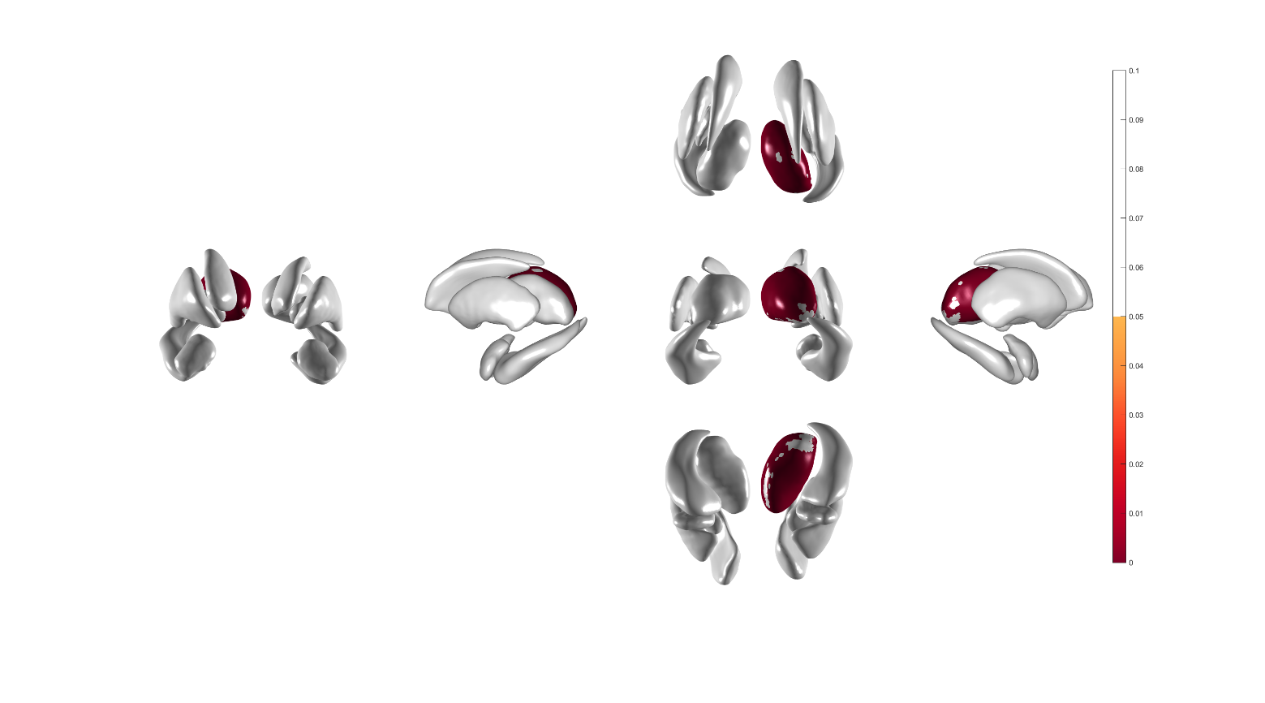
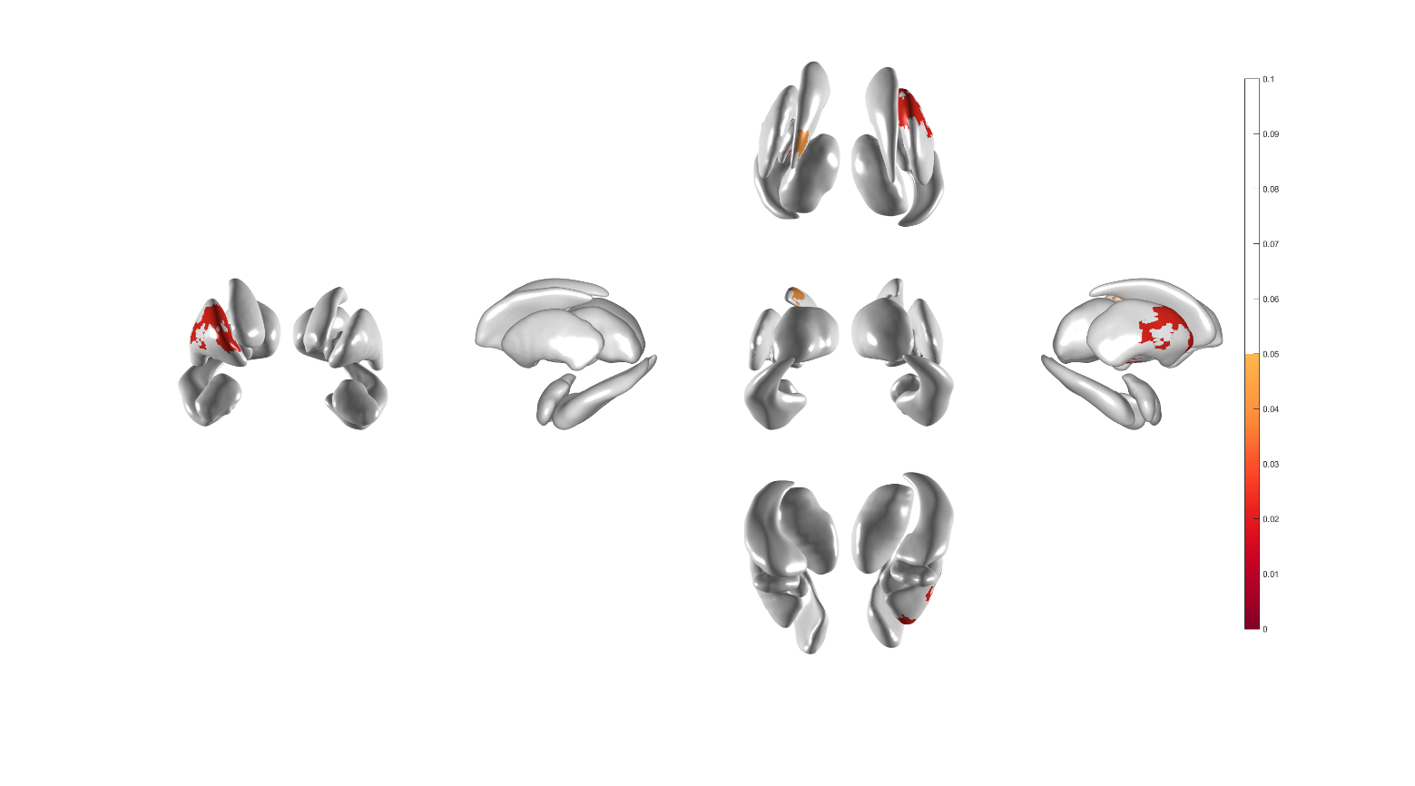
Cluster based statistics (CBS) result
CBS visualization
Threshold 0.35
NMOSD: Right-Thalamus
MS: Left-Caudate, Both-Pallidum, Right-Putamen
Pallidum
Pallidum
Caudate nucleus
Superior → Inferior
Caudate nucleus
Superior → Inferior
Thalamus
Thalamus
Putamen
Putamen
Anterior → Posterior
Amygdala
Hippocampus
Posterior → Anterior
Right
Amygdala
Hippocampus
Posterior → Anterior
Right
Left
Anterior → Posterior
Left
Inferior → Superior
Inferior → Superior
NMOSD
MS

Slide 28


Cluster based statistics (CBS) result
CBS visualization
Threshold 0.4
ICV_BDI_EDSS correct
NMOSD: Right-Thalamus
MS: Left-Caudate, Left-Pallidum, Right-Putamen
Pallidum
Pallidum
Caudate nucleus
Superior → Inferior
Caudate nucleus
Superior → Inferior
Thalamus
Thalamus
Putamen
Putamen
Anterior → Posterior
Amygdala
Hippocampus
Posterior → Anterior
Right
Amygdala
Hippocampus
Posterior → Anterior
Right
Left
Anterior → Posterior
Left
Inferior → Superior
Inferior → Superior
NMOSD
MS

Slide 29
Background
Introduction
Contribution
Method
Result
Discussion
Conclusion

Slide 30
Discussion: Interpretations
Significant local shape volume change related with fatigue scale
NMOSD: (right) thalamus
MS: (left) Caudate, (both) Pallidum, (both) Putamen
Clinical consensus
MS volume analysis: significantly lower volumes on caudate, putamen, thalamus, amygdala, hippocampus [Miklos Palotai, et al. 2019]
NMOSD-typical brain lesions: various regions including hypothalamus, thalamus, etc. [Nadja Borisow, et al. 2018]
Out method implies more localized volume change in NMOSD patients than MS patients
Notes:
[Nadja Borisow, et al. 2018] History of fatigue in multiple sclerosis is associated with grey matter atrophy
[Miklos Palotai, et al. 2019] Diagnosis and Treatment of NMO Spectrum Disorder and MOG-Encephalomyelitis

Slide 31
Discussion: Limitations
Laterality
No sufficient clinical evidences explaining the laterality of subcortical regions correlated with fatigue in NMOSD and MS
Possible evidences
DTI tractography
WMH segmentation map
Other clinical score correlations
Small subjects
More dataset for stronger statistical power
Notes:
PengQi et al.: Neural Mechanisms of Mental Fatigue Revisited: New Insights from the Brain Connectome

Slide 32
Background
Introduction
Contribution
Method
Result
Discussion
Conclusion

Slide 33
Conclusion
Findings
Significant subcortical regions correlated with FACIT-fatigue scale
Contribution
Applied more precise brain subcortical region investigation method to the NMOSD and MS through correlation analysis with fatigue scale

